Slide 1


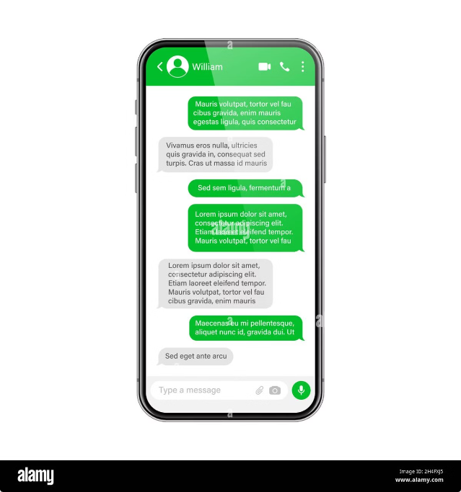

SMS SPAM
Detection
SMS spam is unwanted and annoying text messages, usually sent to many people at once, often trying to sell something or promote a service.
by Pratik Swain
PS
GUIDED BY- MR.SAMBIT SUBHASIS SAHU

Slide 2

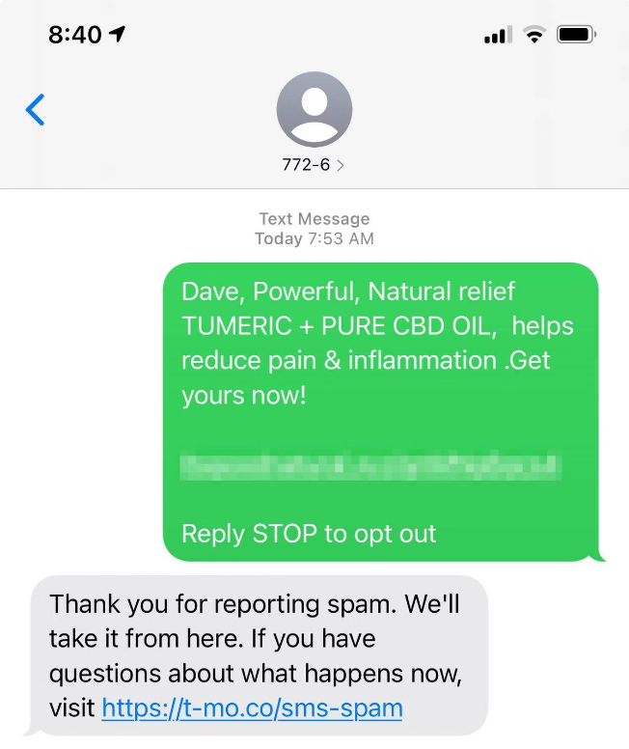
Understanding SMS SPAM
1
Content
SMS spam messages can contain a variety of content, including advertisements, phishing links, and scams.
2
Frequency
The frequency of SMS spam messages can vary, but some people receive multiple spam messages every day.
3
Origin
SMS spam messages can originate from anywhere in the world.
4
Impact
SMS spam messages can be annoying, disruptive, and even dangerous.

Slide 3
Importance of SMS SPAM Detection
User Experience
Security
Brand Reputation
SMS spam can be annoying and disruptive for users. By detecting and filtering out spam, users can enjoy a more enjoyable and productive experience.
SMS spam can be used to spread malware or phish for personal information. Detecting spam helps to protect users from these threats.
For businesses that use SMS marketing, it's important to make sure their messages are not being flagged as spam. This can damage their brand reputation and lead to lost customers.

Slide 4


Techniques for SMS SPAM Detection
Blacklist Filtering
This method involves creating a list of known spam senders and filtering out any messages from those senders.
Keyword Matching
This technique involves identifying keywords that are often associated with spam messages, such as "free," "urgent," or "prize." Messages containing these keywords are flagged as spam.
Statistical Analysis
This method uses statistical analysis to identify patterns in spam messages. For example, spam messages often have a high frequency of certain characters or words.
Machine Learning
This technique uses machine learning algorithms to identify spam messages. Machine learning models can learn from a dataset of known spam and ham messages to improve their accuracy over time.

Slide 5
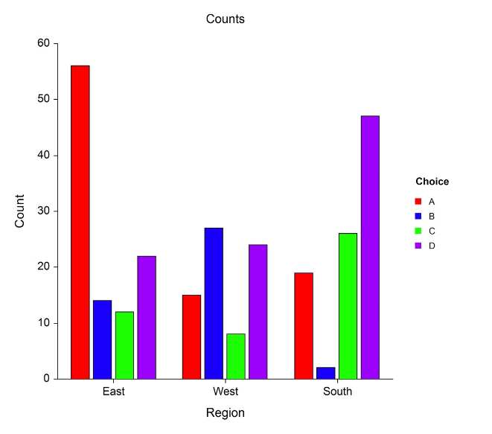
Feature Engineering for SMS SPAM Detection
**Feature**
**Description**
Length of message
The number of characters in the message.
Number of words
The number of words in the message.
Number of digits
The number of digits in the message.
Presence of special characters
Whether the message contains any special characters, such as $, #, or @.
Presence of links
Whether the message contains any links.

Slide 6





Machine Learning Models for SMS SPAM Detection
Naive Bayes
This model uses Bayes' theorem to calculate the probability of a message being spam based on its features.
Support Vector Machine (SVM)
SVM is a supervised learning model that can be used to classify text messages as spam or non-spam.
Neural Networks
Neural networks are a type of machine learning model that can be used to learn complex patterns in data.

Slide 7
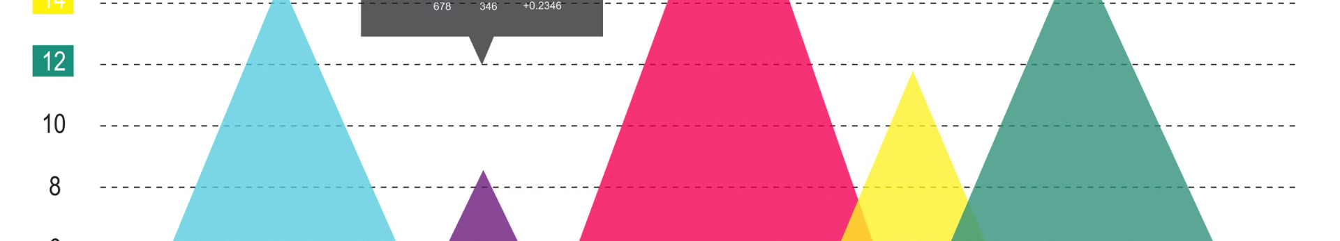




Evaluating SMS SPAM Detection Models
Accuracy
Precision
Recall
F1-score
This metric measures the percentage of messages that are correctly classified as spam or non-spam.
This metric measures the percentage of messages classified as spam that are actually spam.
This metric measures the percentage of spam messages that are correctly identified as spam.
This metric is a combination of precision and recall, providing a balanced measure of model performance.

Slide 8
Implementing SMS SPAM Detection
Data Collection
1
Collect a dataset of SMS messages that have been labeled as spam or ham.
2
Data Preprocessing
Clean and prepare the data for use in a machine learning model.
Model Training
3
Train a machine learning model on the prepared data.
4
Model Evaluation
Evaluate the performance of the trained model using appropriate metrics.
Deployment
5
Deploy the trained model into a real-world system for SMS SPAM detection.

Slide 9


Conclusion
SMS SPAM detection is an important task for protecting users and improving their experience.

Slide 10

THANK YOU

